Slide 1
BIOE 498 / BIOE 599: Computational Systems Biology for Medical Applications CSE 599V: Advancing Biomedical Models Lecture 13: Model Engineering
Joseph L. Hellerstein*
Herbert Sauro**
*eScience Institute, Computer Science & Engineering
**BioEngineering

Slide 2
Common Complaints About BioMedical Models
Reproducibility
agreement between the results of measurements of the same measurand carried out with same methodology described in the corresponding scientific article
Readability (from software engineering)
how easily code can be read and understood
Reuse
use of existing components to build a new system

Slide 3


Slide 4
Readability Ouzounoglou2014 - Modeling of alpha-synuclein effects on neuronal homeostasis (#559)
s3 -> s17;
s3 -> s22;
s17 -> s18;
s17 + s22 -> s7;
s17 + s51 -> s78;
s18 -> s521;
s18 + s17 -> s20;
s18 + s51 -> s85;
s20 -> s520;
s20 + s17 -> s24;
…
135 reactions
Difficult to understand model
Species names are not revealing.
Reactions are not organized to facilitate interpretation.

Slide 5
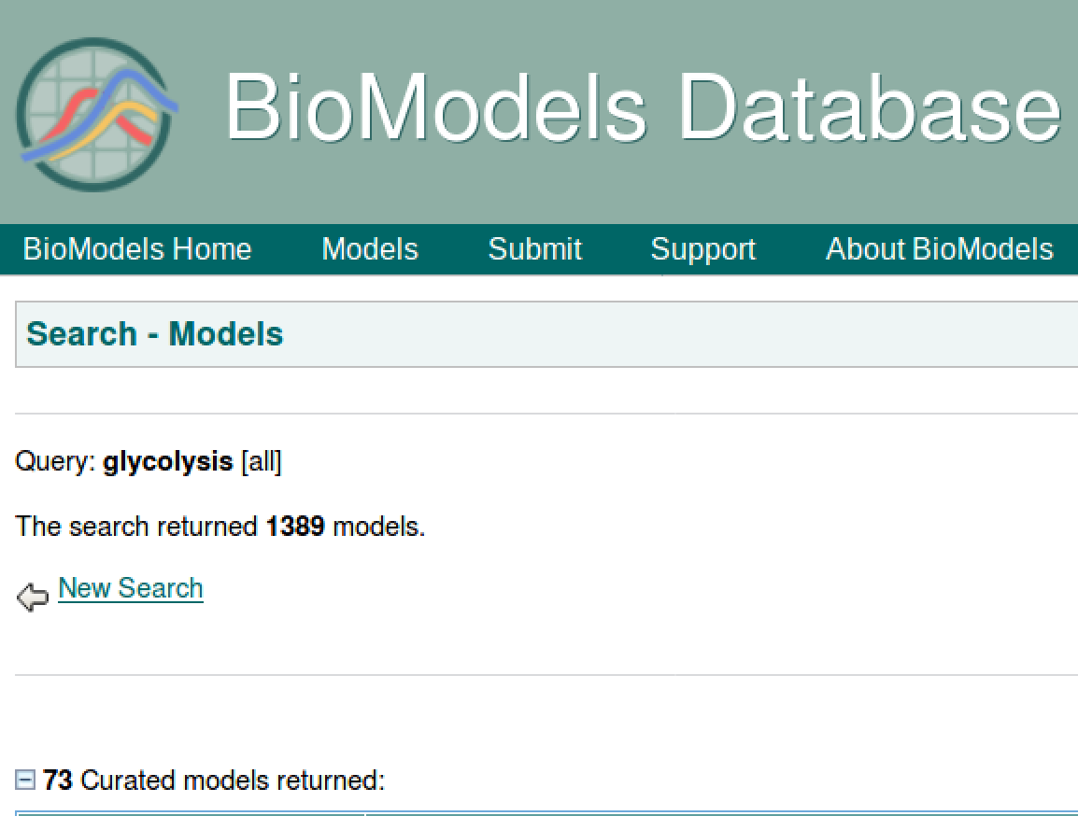
Reuse
Why are there so many glycolysis models?

Slide 6
Metabolic Pathways in Yeast (Nature

Slide 7
Software Engineering Background
Requirements
Design
Construction

Slide 8

Running Example: Design of ATM

Slide 9
Requirements: What Do We Do With ATMs?
Get cash
Deposit checks
Check balances
These are examples of Use Cases.
Implied use case – User authentication.

Slide 10
Describing a Use Case
What information the user provides
E.g., command entered with its options
What responses the system provides
E.g., prompts, plots, error messages
Authenticate User Use Case
User: Put ATM card in reader
ATM: Display 'Enter PIN'
User: Enters PIN on keyboard
ATM: [if correct] Show main menu
[if incorrect] Display 'Enter PIN'

Slide 11
Use Cases for Models
Build
Validate
Verify
Estimate parameters
Predict

Slide 12
Component Design Modularity, Modularity, Modularity
Modularity is the degree to which a system's components may be separated and recombined, often with the benefit of flexibility and variety in use.

Slide 13
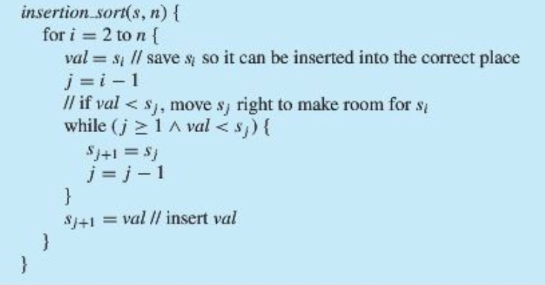
Interface, Implementation and Information Hiding
Interface
void sort(int ar[])
Implementation
Information hiding. Internals of the sort algorithm are hidden.
void sort(int ar[])
Can change the implementation at will if the interface is unchanged and use information hiding.

Slide 14
Reuse is achieved in software by information hiding.
Information hiding is problematic for biomedical models since different models may have the same or interacting chemical species.

Slide 15
Software Construction
Linting
Version control

Slide 16
Linter: Checks for static errors

Slide 17
Version Control System
Tracks changes to documents, detects conflicts, merges changes, and provides access to older versions.
This is accomplished by having a graph of changes made and being able to navigate and modify the graph.

Slide 18
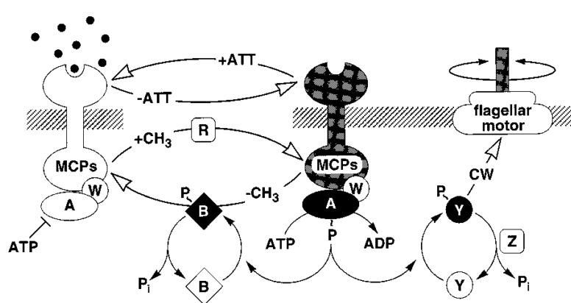
Chemotaxis System (Spiro, 1999)
L
2,3,4
T
p
L - Ligand
p – Inorganic phosphate
2,3,4 – Levels of methylation
Chemotaxis System (Spiro, 1999)
L
2,3,4
T
p
L - Ligand
p – Inorganic phosphate
2,3,4 – Levels of methylation

Slide 19
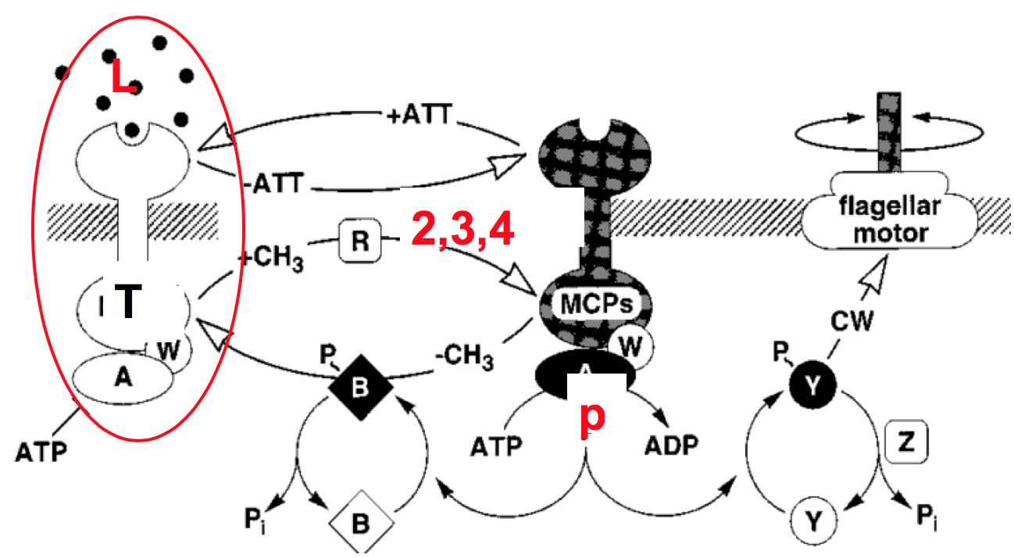
Reactions with 2 to 5 Levels of Methylation
T2pR => T3p + R; kf*T2pR - kr*T3p*R
T3p => T3 + p; kf*T3p - kr*T3*p
T3p => T2p + m; kf*T3p - kr*T2p*m
T2p + R => T2pR; kf*T2p - kr*T2pR
T3pR => T4p + R; kf*T3pR - kr*T4p*R
T4p => T4 + p; kf*T4p - kr*T4*p
T4p => T3p + m; kf*T4p - kr*T3p*m
T3p + R => T3pR; kf*T3p - kr*T3
T4pR => T5p + R; kf*T4pR - kr*T5p*R
T5p => T5 + p; kf*T5p - kr*T5*p
T5p => T4p + m; kf*T5p - kr*T4p*m
T4p + R => T4pR; kf*T4p - kr*T4
Very repetitive.
Can we do better?

Slide 20
Using Tellurium Model Construct
model complex()
TpR => Tmp + R; kf*TpR - kr*Tmp*R
Tmp => Tm + p; kf*Tmp - kr*Tm*p
Tmp => Tp + m; kf*Tmp - kr*Tp*m
Tp + R => TpR; kf*Tp - kr*TpR
kf = 1
kr = 1
end
Me2: complex();
Me3: complex();
Me4: complex();
Me3.Tp := Me2.Tmp
Me3.m := Me2.m
Me3.p := Me2.p
Me4.Tp := Me3.Tmp
Me4.m := Me3.m
Me4.p := Me3.p

Slide 21
Class Exercise: BioModels 569 Dutta-Roy R, Rosenmund C, Edelstein SJ, Le Novère N. Ligand-dependent opening of the multiple AMPA receptor conductance states: a concerted model. PLoS ONE 2015; 10(1): e0116616
Use the Tellurium Model construct to modularize the reactions. (Don’t worry about the kinetics.)
Notes:
Should show modules.

Slide 22
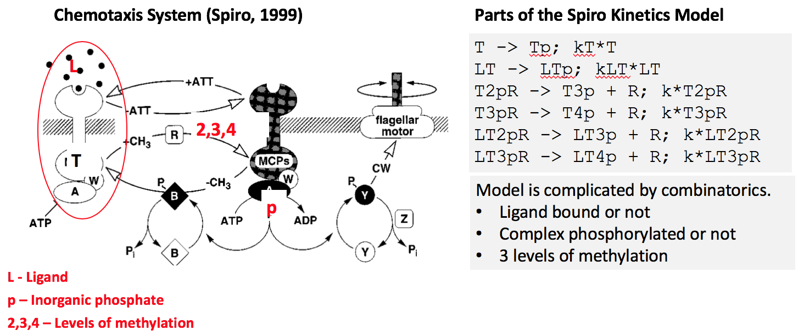
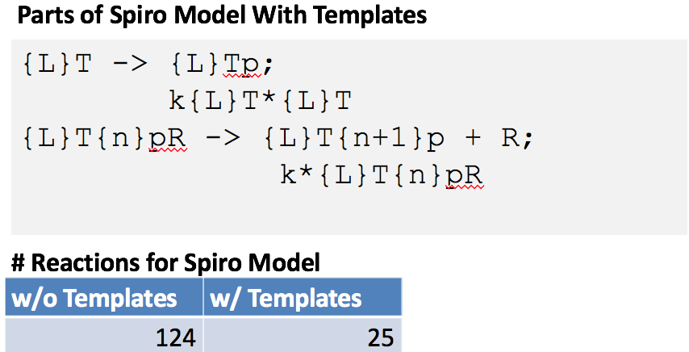
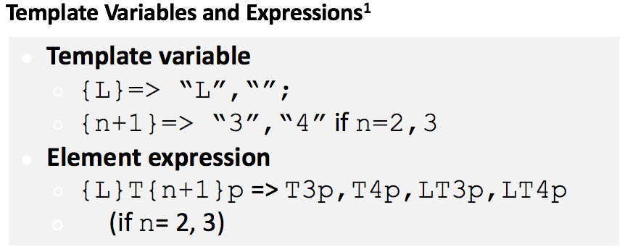
Templates
Template language: ”meta” programming language that operates on another programming language.
TemplateSB
Notes:
Do templates for the previous example.

Slide 23
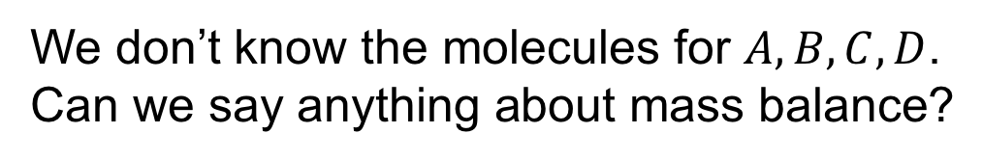

Linting and Mass Balance
$$A→B+C$$
$$B→D$$
$$C→A$$
$$D→A$$
We don’t know the molecules for $A,B,C,D$.
Can we say anything about mass balance?

Slide 24
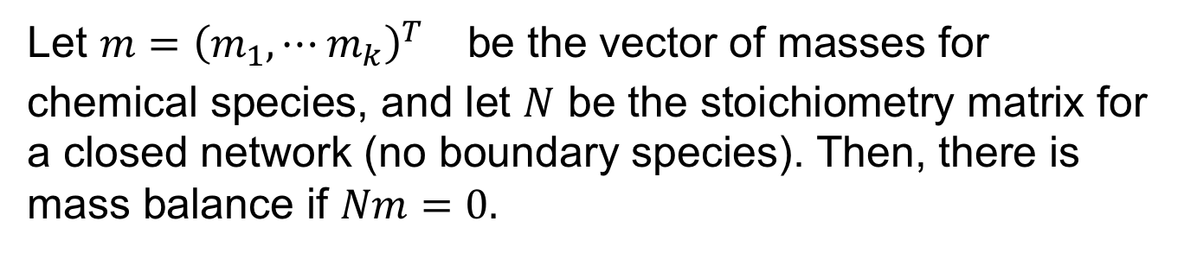
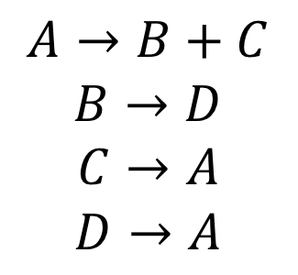
Analysis of Mass Balance for Unknown Species
 | A | B | C | D
1 | -1 | 1 | 1
2 |  | -1 |  | 1
3 | 1 |  | -1
4 | 1 |  |  | -1
$$A→B+C$$
$$B→D$$
$$C→A$$
$$D→A$$
Stoichiometry Matrix
Let ${m={\left(m_{1},⋯m_{k}\right)}^{T}}_{}$ be the vector of masses for chemical species, and let $N$ be the stoichiometry matrix for a closed network (no boundary species). Then, there is mass balance if $Nm=0.$

Slide 25
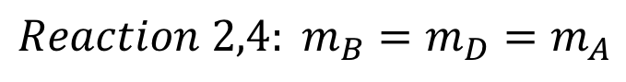

Analysis
 | A | B | C | D
1 | -1 | 1 | 1
2 |  | -1 |  | 1
3 | 1 |  | -1
4 | 1 |  |  | -1
$$A→B+C$$
$$B→D$$
$$C→A$$
$$D→A$$
Stoichiometry Matrix
Assume mass balance and look for a contradiction.
$$Reaction 1: m_{A}>m_{B}$$
$$Reaction 2,4: {m_{B}=m}_{D}=m_{A}$$
No mass balance.

Slide 26
In Class Exercise
Is there mass balance in BioModels 563?
R_0 + PAMP -> + PRR;
R + E_int -> + R_0;
Path_bulk -> + Path_bulk + Path;
Path -> + PAMP + Path;
Path -> + E + Path;
Path + R_0 -> + R_0;
E -> + E_int;
PRR -> + PRR + Callose;
Path + Callose -> + Callose;
Callose + E_int -> + E_int;

Slide 27
Elements of the Model Engineering Agenda
Modeling Barrier | Software Engineering Technique
Large and redundant models | Template systems expand to full web pages (e.g., Jinja)
No static error checking | Linters find undefined variables (e.g., atom editor)
Model reuse is minimal | Novel software abstractions and information hiding
Model debugging is onerous | Interactive debuggers (e.g., python’s pdb)

